Slide 2
Marketing Strategies for your ccTLD and the importance of your sales channel
Jon Lawrence
AusRegistry International
Bled, Slovenia
7th September 2009
Notes:
Firstly, I hope my accent is not too difficult to understand. Please ask me to slow down if I’m talking too fast.
Today I want to share with you some thoughts on marketing strategies for your ccTLD and about the importance of your sales channel. These are based on our experiences working with a number of ccTLDs.
Our CEO, Adrian Kinderis, presented to the meeting last year in Sofia, but was unable to make it this year, so I’m here instead.

Slide 3
AusRegistry International
Based in Melbourne, Australia
Founded in 1999
.AU Registry Operator since 2002
.AE Registry Software provider (ASCII & IDN)
.QA Registry Software provider (ASCII & IDN)
Notes:
So, who are AusRegistry International?
Well we’re based in Melbourne, Australia and are the international arm of AusRegistry, the Registry Operator for .AU. We were founded in 1999 and have been operating the .AU registry since 2002.
In 2006 we were selected to be the software provider for the .ae ccTLD and have IDN-enabled our Registry software to facilitate their application for an Arabic ccTLD as part of the Fast Track Process.
We’re also very excited that we’ve just been selected as the Registry Services provider for the .qa ccTLD in Qatar, for also their ASCII and Arabic ccTLD requirements.

Slide 4
AusRegistry International
Doha, QATAR (.QA)
Dubai, UNITED ARAB EMIRATES (.AE)
Bled, Slovenia
Melbourne, AUSTRALIA (.AU)
Notes:
In case anyone is unsure where any of these places are, here’s a map.

Slide 5
AusRegistry International
Domain Name Registry Systems and Software
EPP-based Registry/Registrar model
Full IDN, DNSSEC & IPv6 support
ccTLDs and new gTLDs
Consultancy
Policy, Marketing, Administration
Training services
Notes:
So, what do we do?
We provide a range of services including registry software, hosted registry services and consultancy and training.
Our systems are built on an EPP-based Registry/Registrar model and include full support for IDNs, DNSSEC and IPv6

Slide 6
Agenda
Registrant choices
Marketing your ccTLD
Regulator
Registry
The sales channel
Notes:
So, that’s who we are.
First, I’ll talk about the range of choices that exist in the current market.
Then I’ll talk about some strategies and approaches for the marketing of a ccTLD, looking at this from the perspective of the Regulator and the Registry, and will provide some examples in each case.
Then, I want to talk about sales channels in the domain market and why they’re so important.

Slide 7
Registrant choices
Local ccTLD
gTLDs
Regional TLDs
‘Repurposed’ ccTLDs
Notes:
There are many choices out there in the market place for any new registrant, regardless of where they are based.
The local ccTLD will be an obvious starting point for many, for example .RU
The other obvious choice for many will be .COM, if the desired name is available, or perhaps one of the other gTLDs, such as .ORG or .BIZ.
Or they may look to a transnational or regional TLD like .EU or .ASIA.
Then there are the ‘repurposed’ ccTLDs, such as .TV, .ME & .NU that are effectively also generic spaces.

Slide 8
Registrant choices
Many more choices coming soon!
IDN ccTLD Fast Track program (late 2009)
New gTLD program (2010)
Increasingly competitive global market
Notes:
This range of choice is of course about to become much wider through the new gTLD and IDN ccTLD Fast Track programs.
In this increasingly competitive global market, it’s therefore critically important that ccTLDs have clearly defined and effective marketing strategies to ensure they are not lost in the crowd.

Slide 9
Registrant choices - influences
Knowledge & awareness
Advice and recommendations
Cost
Availability of quality names
Ease of registration
Notes:
So what are the major influences on registrants when they come to choose a TLD?
Clearly there are different types of registrants and they’re going to be influenced by different things. These are some factors that should influence most registrants, regardless of whether they’re a government body, an educational institution, a small, medium or large business, a non-profit organisation or an individual.
A major influence will be the level of knowledge and awareness that the person has about their options. If someone isn’t aware of the local ccTLD, then they’re pretty unlikely to make it their first choice. On the other hand, I think we can assume that everyone that’s had some exposure to the internet is aware of .com. Of course, potential registrants will seek advice and recommendations, from the sales channel!
Cost will of course always be a major influence. In many countries, the relative cost of the local ccTLD is a major barrier to uptake.
Availability of quality names is also another major factor which often works against gTLDs, particularly .com.
Ease of registration - any paperwork or other requirements that delay the registration process will inevitably effect demand for a ccTLD.

Slide 10
Marketing your ccTLD

Slide 11
Different approaches
Regulator
Registry
Registrars, Resellers (the Sales Channel)
Notes:
There are three primary functions within a ccTLD - the Regulator, the Registry and the sales channel, made up of registrars and resellers. Each function has a different role to play in the marketing of a ccTLD.
Depending on the industry model, these functions may be managed by different organisations or they may all be part of the same organisation. Let’s quickly review the three main industry models.
I’m now going to outline what we see as the role that the Regulator and Registry have to play in the marketing context. There will of course be cross-over between each of these roles depending on the precise nature of the relationships involved.

Slide 12
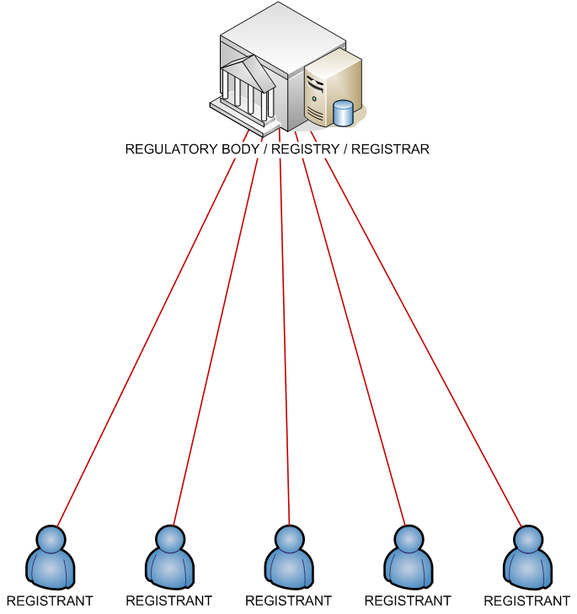
Direct model
Notes:
Firstly, the Direct model.
Many ccTLDs, in this region and elsewhere, still offer direct registrations, as displayed here. In this scenario the registrant has a direct relationship with the organisation which fulfils all three functions – regulator, registry and registrar.

Slide 13
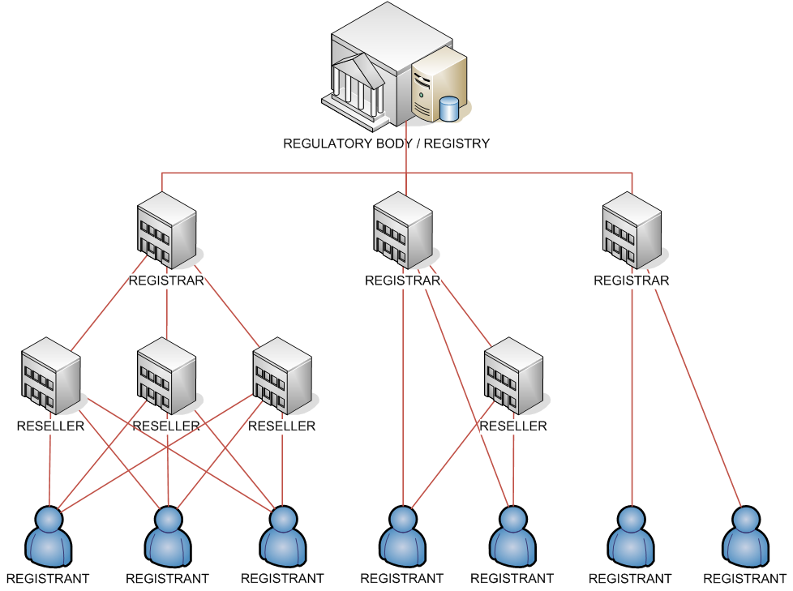
Registry/Registrar model
Notes:
Many others have formal sales channels, including registrars, some of whom will have resellers of their own, yet the regulator and registry is still one organisation.
In this model, the registrars or resellers manage the customer and therefore play a very important role in the success or otherwise of any ccTLD.

Slide 14
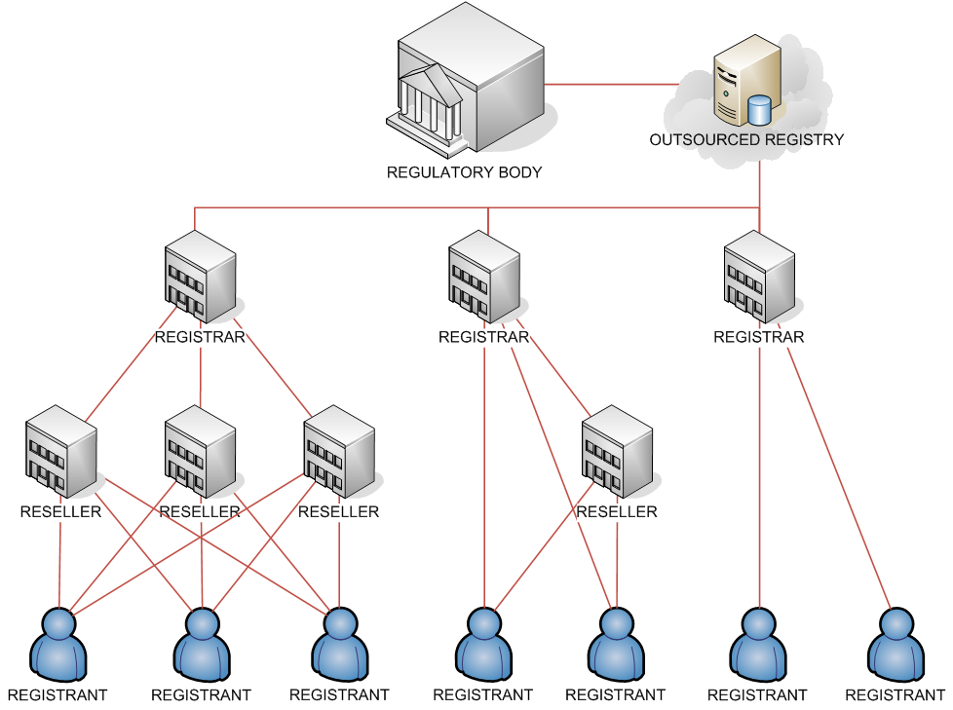
Outsourced Registry model
Notes:
Finally, there is the outsourced Registry model, which is what we have in .AU, where each function is managed by separate organisations.

Slide 15
Strategies - Regulator
Promote local ccTLD as the FIRST CHOICE
The Billboard test
Public awareness and education
Leverage national pride
Policy
Clearly defined policy that suits the national interest
Reputation
Promote and protect
Notes:
So, I’d like to now talk about the role of the Regulator in marketing a ccTLD.
The primary focus should be on ensuring that the ccTLD is promoted as the first choice for local businesses and also for international businesses trading within the country.
A good way to test this is what we call ‘The Billboard test’. When you fly home, look at the advertising billboards by the side of the road into town from the airport. If these are displaying your ccTLD, then you’re in good shape. If they’re displaying .com or other TLDs, then you’ve got work to do.
When we took over .AU in 2002, .com was probably the dominant brand in Australia. Now, we’re very proud to say that the dominant brand is .AU. We’ve put a lot of work into making that happen and I’m going to share some of our experiences with you today.
So, public awareness and education is clearly an important part of the mix. You can leverage national pride in this context.
Clearly defined policies that suit the national interest are obviously a key role of the Regulator but they can also play a role in the marketing of a ccTLD. This is certainly the case in .AU, where the relatively strict local presence requirements ensure that the domain space has a strong reputation with the Australian community. Users have confidence that when they see .AU, they are getting a legitimate Australian website.
Promoting and protecting the reputation of the ccTLD is therefore also clearly an important part of the Regulator’s marketing role.

Slide 16
Approaches - Regulator
Public relations
Information seminars
Press briefings
Press releases
Promotion of local content
Surveys
Collateral
Brochures
Promotional items
Audio-visual tutorials
Notes:
To achieve these sorts of outcomes, the following approaches are likely to be useful:
Public relations should be central to any strategy at this level. This can include information sessions for industry members and other interested stakeholders, press briefings and press releases about notable events and milestones.
- You should look at ways of promoting local content.
Surveys are also a great way to find out more about the level of awareness within the community, but also to generate press coverage.
You should also consider producing a range of generic marketing collateral to be used in a variety of contexts.

Slide 17
Brochures
Notes:
Here are two examples of generic brochures produced by auDA to promote the .AU domain space. The green one on the left is a high-level explanation of the DNS and how .AU is structured. The red one on the right is focussed on why people should choose .au.

Slide 18
Tutorials
Notes:
auDA also commissioned some professionally-recorded tutorials that discuss how businesses and consumers can get started with an internet presence and then how make the most out of it.
The growth of online video sites such as youtube makes this sort of collateral increasingly easy to distribute and therefore powerful.

Slide 19
Strategies - Registry
Branding
Create & promote distinctive ccTLD brand
Style guides
Logos
Licensing agreement to cover usage by Registrars
Publicity
Anchor tenants
Sales Channel
Market to and through the sales channel
Notes:
So that’s an overview of the role of the Regulator. Let’s turn now to the Registry’s role.
The Registry should create and promote a distinctive brand for the ccTLD. Branding is a critical element of any marketing campaign. You should engage a professional agency to help you create logos and a style guide to ensure consistent usage. You should also look at a licensing agreement that will allow your registrars and other parties to use these.
Clearly, publicity is another element which can be very useful.
Anchor tenants are a great way of leveraging the marketing budgets of much larger organisations
Perhaps most importantly though, the Registry needs to market to (and through) the sales channel. I’ll talk about that in more detail shortly.

Slide 20
Branding
Notes:
Here are is an example of TLD branding that we developed, which highlights the different second level domains available within .AU and tries to give each one something of a personality.

Slide 21
Logos
Notes:
Here are some logo examples.

Slide 22
Publicity
Notes:
When .AU reached 1 million names, we put together a broad publicity strategy to celebrate the achievement and to play on the idea of national identity.
This publicity included press advertisements, such as this one.

Slide 23
Anchor tenants
Leverage much larger marketing budgets
Portals
Media sites
Other high-profile sites
Notes:
Anchor tenants are high profile websites that use your local ccTLD as their primary address.
They are a very effective way of promoting a ccTLD as they allow you to leverage the marketing budgets of much larger organisations.
Likely anchor tenants would be portals, media organisations or other high profile sites.
In some circumstances, it may be worth paying a potential anchor tenant to switch to your ccTLD.
One great recent example is the launch of wp.me by Wordpress as a URL-shortening service.

Slide 24
The sales channel
Notes:
Much of the Registry’s marketing efforts should however be directed towards the sales channel to encourage them to market your ccTLD to their customer base and thereby to drive registration growth.

Slide 25
Importance of your sales channel
Customer relationship
First point of contact with potential registrants
Own the customer relationship
Educational role
Build awareness
Drive increased registration volume
Notes:
So why is the sales channel so important?
The sales channel will almost always be the first point of contact with potential registrants and will therefore play a significant role in determining whether or not they choose the local ccTLD as their first option. Where a registry/registrar model exists, the registrar will own the customer relationship and must therefore be involved at all stages.
Even where a direct registration model exists, registrants will still have a relationship with their hosting provider and will often turn to them first for advice or support.
The sales channel has an important role to play in terms of educating the market and building awareness of a ccTLD in this increasingly competitive global market.
The sales channel is also, of course, the easiest way to drive increased registration volumes.

Slide 26
What does the sales channel want?
Ask them!
Margin
Ease of integration
Online management tools
Clearly defined policy
Product flexibility
Lead generation
Marketing support
Notes:
So what does the sales channel want?
Well, obviously, the best way to answer this question is to ask them. These are some of the most likely candidates, based on our experience.
Firstly, they want to be able to make a margin on domain registrations, ideally through some form of wholesale pricing structure.
Ease of integration is also a very significant factor, especially for the volume players in the market. Using a standard registrar interface such as EPP is a big advantage in this context.
Online management tools are desirable for a number of reasons.
Clearly defined policies are also important as they provide certainty and facilitate the automation of many functions.
Product flexibility – domain names are just one part of the puzzle for the sales channel and flexibility to create attractive packages is important.
Lead generation – your sales channel will always be looking for leads.
Marketing Support – promotions and other marketing support will also always be attractive to the sales channel.
And, last but not least, the sales channel is always looking for more leads.

Slide 27
Lead generation
Promotional websites
Public awareness
Qualified leads -> Registrar websites
Special offers
Qualified leads -> Registrar websites
Notes:
Promotional websites are a great way of combining public awareness campaigns with proactive lead generation.
Special offers are another great way of generating leads.

Slide 28
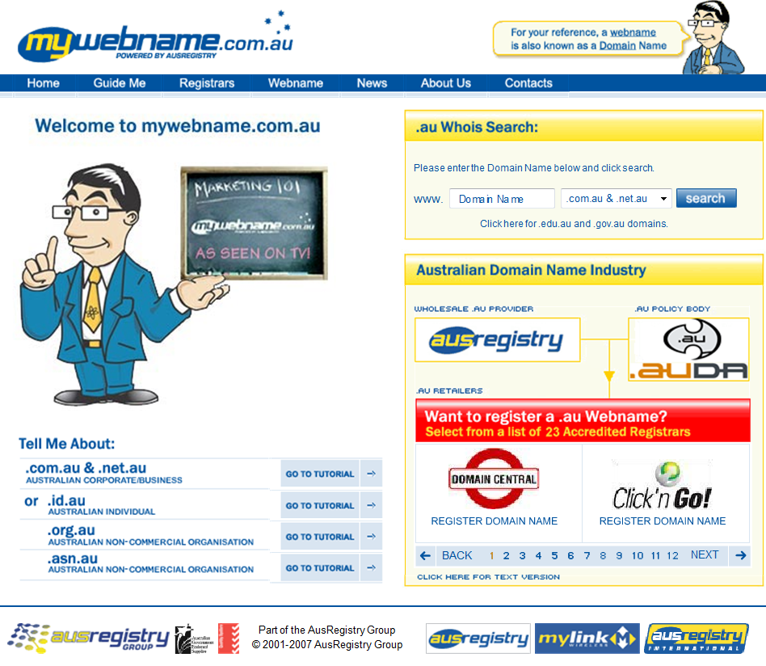
Promotional website - .AU
Notes:
mywebname.com.au is a promotional website that we developed to try to break through some of the industry jargon and to talk to end-users in language they can understand. This site then refers users onto registrars to register their name.

Slide 29
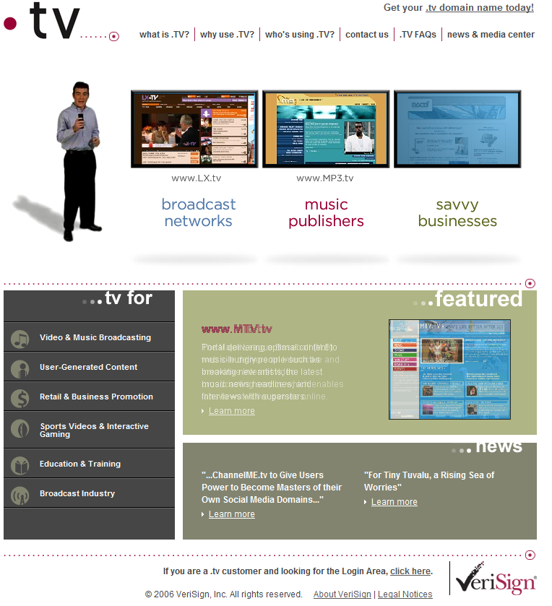
Promotional website - .TV
Notes:
This is the website that Verisign has developed to promote the .TV domain space.

Slide 30
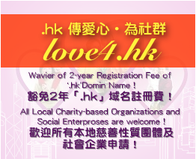
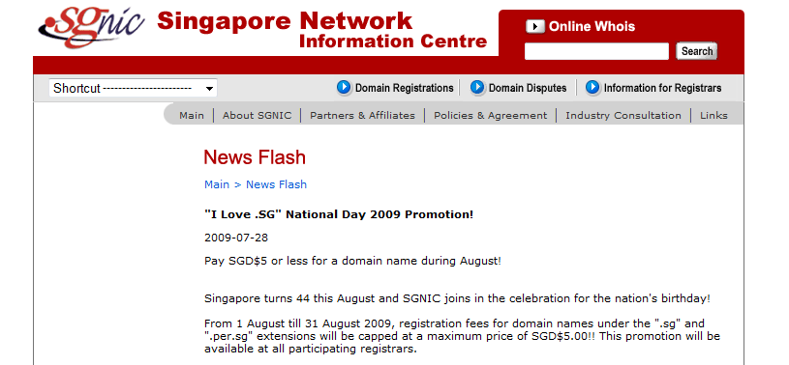
Special offers
Notes:
Here are some special offers from our friends in Asia, all of which are designed to drive registrations through the channel.

Slide 31
Marketing support
Subsidy programs
Controlled funding of specific campaigns
Co-op Marketing programs
Encourage general marketing by reimbursing marketing spend
Marketing funds programs
Rebate percentage of additional sales revenue
Notes:
There are a number of methods through which you can provide marketing support to your channel.
Subsidy programs – provide subsidies to assist with specific marketing campaigns
Co-op Marketing programs – reimburse your registrars for their marketing spend in relation to your ccTLD
Marketing funds programs
provide rebates based on the increase in sales revenue
I can provide some detailed examples of each of these types of programs if anyone is interested.

Slide 32
Summary
Increasingly competitive market
Build your ccTLD brand
Understand your sales channel
Work with your sales channel to drive registration growth
Notes:
So, in summary, some things to take away.
The domain name market is increasingly competitive.
To be successful, a ccTLD manager must build the ccTLD brand and must understand and work with the sales channel to drive registration growth.

Slide 33
Questions?
jon.lawrence@ausregistry.com
www.ausregistry.com
Notes:
And, here is a picture of a Kangaroo.

